Slide 1
Demystifying Serverless Computing
aka.ms/RocAzure
March 2018
Trey Talbott Mike McKechney Anthony Martin
trey.talbott@microsoft.com michael.mckechney@microsoft.com anthma@microsoft.com
@treytalbott @mmckechney @SQLMartini

Slide 2
Agenda
Opening Remarks
RocAzure Charter
Introductions
First timers.
Review Calendar
What’s new?
Azure Updates and Roadmap
Keynote
Wrap up and Network

Slide 3
Rochester User Group Charter
Salesy
Stuff
Cloud computing is a journey.
This User Group exists to:
Serve a community of Azure enthusiasts
Demystify cloud computing concepts
Help accelerate your cloud journey
Stay current on Azure capabilities
Help each other with the journey
Share real world experiences and lessons learned

Slide 4
Introduction of first timers
Please share your:
Name and background
Cloud experience, if any
Azure, AWS, Google, etc…
What are your expectations being here
i.e., how can this group help you?
Fun fact

Slide 5
Upcoming Events
User Groups
April 11 – AccuWeather Community Case Study
May 9 – Demystifying Big Data technologies and solutions for the cloud
Other notable events
May 7-9 Microsoft Build, Seattle

Slide 6
Azure Training and Certification
New learning resources: https://aka.ms/azure-learning
Learning Paths
Advanced skills
Certification
Azure learning paths by job functions to build practical job skills
For technical professionals:
On-premises IT
Hybrid IT
Developers (.NET, Node.js)
AWS professionals
Advanced training provided by Learning Partners
For technical professionals:
Wanting deeper learning
Starting a new IT role
Companies requiring training for IT teams
Microsoft Certified Professional (MCP) exam bundle aligned to job roles
For technical professionals:
Seeking to validate their skills
Needing high-value credential to demonstrate achievement

Slide 7
Staying Current
azure.com/updates
azure.com/blog
azure.com/roadmap

Slide 8
Serverless Patterns with Azure

Slide 9
The “evolution” of application platforms
On-Premises
IaaS
Containers
PaaS
Serverless

Slide 10
Modernize your apps with PaaS
Value to business
Innovation
PaaS
Efficiency
IaaS
Time

Slide 11
Build apps faster with Serverless
Serverless
Value to business
Innovation
PaaS
Efficiency
IaaS
Time

Slide 12
What is “serverless”
Abstraction of servers
Event-driven scale
Sub-second billing

Slide 13
How is it different
Mono-lithic application
Inside client app
Complex framework
Loosely coupled components
Outside client app
Micro-functionality

Slide 14
Benefits of “serverless”
Ship faster
Reduced dev ops
Focus on business logic

Slide 15








Serverless application platform components
Development
Platform
IDE support
Functions
Logic Apps
Event Grid
Developer productivity
Triggers and Bindings
Flexible deployment options
Visual designer
170+ connectors
Functions orchestration
Manage all events in one place
Near real-time delivery
Broad coverage
Integrated DevOps
Local development
Monitoring
Database
Storage
Security
IoT
Analytics
Intelligence
Visual Debug History

Slide 16
Signs that a serverless pattern might be useful for a given scenario
Stateless → Scale
Not worth deploying a traditional backend
Workload is sporadic (very low & high scale)
Dev ops favored versus dedicated ops
Lots of different services involved that need “glue”

Slide 17
Applications
Example: Timer based processing
Eve
r
y 15 minutes
Find and clean invalid data
Clean table

Slide 18
Applications
Example: Azure service event processing
CSV
File added to
T
ransfo
r
m CSV to data
r
ows
P
ower BI
Blob Storage
Cha
r
t graphic

Slide 19
Applications
Example: SaaS event processing
Excel file saved
Mic
r
os
o
f
t Graph API analyzes content
C
r
eates new sheets
to OneDrive
with cha
r
ts

Slide 20
Applications
Example: Serverless Web Applications architectures
Loaded web page
C
r
eate ad based on user p
r
o
file
Completed page
calls
W
ebHook

Slide 21
Async background processing
Example: Serverless Mobile back ends
Photo taken and
Sto
r
es in blob storage
P
r
W
ebHook called
oduces scaled images

Slide 22
Applications
Example: Real-time stream processing
Millions
o
f devices feed
T
ransfo
r
m to structu
r
ed data
Sto
r
e data in
into St
r
eam Analytics
SQL Online

Slide 23
Applications
Example: Real-time bot messaging
...
?
Co
r
tana Analytics answe
r
Message sent
s questions
Chatbot sends
to Chatbot
r
esponse

Slide 24


Integration
Example: Invoice Processing
API Management
Logic App
Function
Post new invoice
Convert to JSON
Grab raw file
Store record
API layer
Fetch Invoice

Slide 25































































Platform Services
Security & Management
Hybrid
Cloud
Media & CDN
Application Platform
Data
Security Center
SQL
Database
Azure AD
Health Monitoring
Media Services
Media Analytics
Content Delivery
Network
Web
Apps
Mobile
Apps
SQL Data
Warehouse
DocumentDB
Portal
AD Privileged
Identity
Management
Azure Active
Directory
Integration
SQL Server
Stretch Database
Redis
Cache
Storage
Tables
Azure
Search
API
Apps
Cloud
Services
Azure AD
B2C
API
Management
BizTalk
Services
Domain Services
Service
Fabric
Notification
Hubs
Intelligence
Multi-Factor
Authentication
Logic
Apps
Service Bus
Functions
Cognitive Services
Bot Framework
Cortana
Backup
Automation
Developer Services
Analytics & IoT
Operational
Analytics
Compute Services
Scheduler
HDInsight
Machine
Learning
Stream Analytics
Container
Service
VM
Scale Sets
Visual Studio
Mobile
Engagement
Import/Export
Key Vault
Data
Catalog
Data Lake
Analytics Service
Data Lake Store
Store/
Marketplace
Batch
RemoteApp
VS Team Services
Xamarin
Azure Site
Recovery
Application
Insights
HockeyApp
IoT Hub
Event
Hubs
Data
Factory
Power BI
Embedded
VM Image Gallery
& VM Depot
Dev/Test Lab
StorSimple
Infrastructure Services
Compute
Storage
Networking
Virtual Machines
Containers
Blob
Queues
Files
Disks
Virtual Network
Load Balancer
DNS
Express
Route
Traffic Manager
VPN Gateway
App
Gateway
Datacenter Infrastructure (32 Regions, 24 Online)

Slide 26








Azure Functions
Serverless
Accelerate development
Bind into services
Azure Service Bus
Azure Event Hub
Azure Storage
</>
Dropbox
Sendgrid
AzureDocDb
Event-driven scale
Reduced Dev Ops
Develop your way
Local development
OneDrive
Box
Twilio

Slide 27
Azure Functions architecture
Azure Functions is built around the WebJobs SDK runtime. The WebJobs SDK makes it easy to react to events and work with data in a consistent abstracted fashion.
App Service Dynamic Runtime
WebJobs Core SDK
WebJobs Script Runtime
Triggers
Code
Inputs/ Outputs
WebJobs Extensions
Config
Language Abstraction

Slide 28
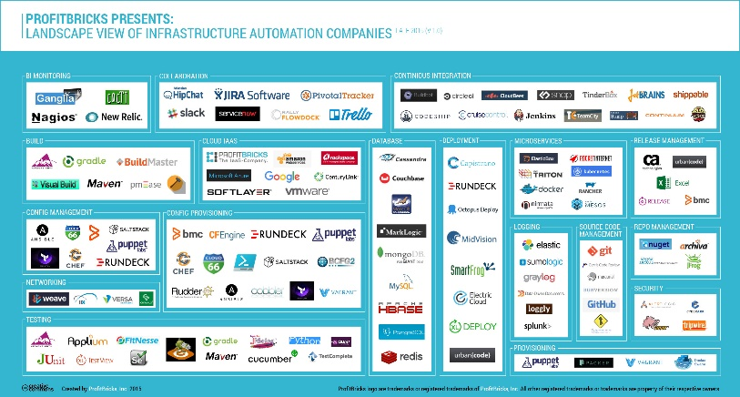
Microservice tools and approaches
Microservices in the wild
Azure Functions
Azure Service Fabric
Implication: Build your own microservices platform
Benefits: Customizable, pick best of breed solutions
Implication: Serverless microservices
Benefits: Quick ramp up, sub second metering, zero ops
Implication: Prescriptive microservices platform
Benefits: Easy to build, deploy and manage microservices at scale
Event-driven scale
No Ops

Slide 29

Dual abstraction
Serverless compute abstracts away the compute
Bindings abstract away the services you interact with
Other Services
Business Logic
Serverless PaaS

Slide 30
Platform and scaling
App Service offers dedicated and dynamic tiers.
Dedicated is the existing App Service plan tiers
Basic, Standard, Premium
Pay based on # of reserved VMs
You’re responsible for scale
Dynamic
Pay on number of executions
Platform responsible for scale

Slide 31
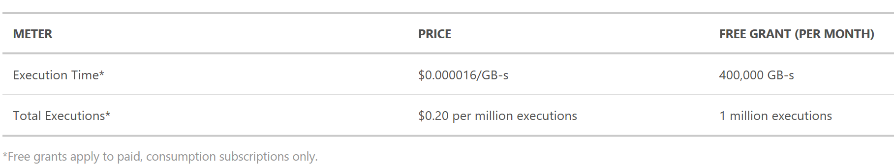
Dynamic tier pricing
Pay per execution model - two meters, three units
Number of executions
Duration of execution x reserved memory

Slide 32
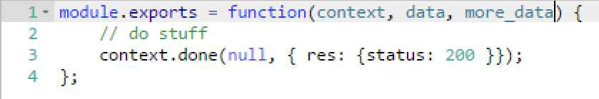
Functions programming concepts
Trigger
Input
Code
Output

Slide 33


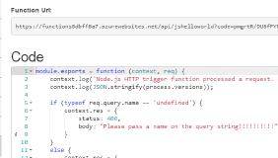
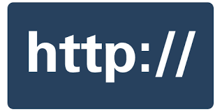


1) Trigger
2) Input Binding
3) Develop
4) Execute
5) Output Binding
Web
Hooks
App Services
Hosting Plans
Azure Services
Azure Services
Azure Services
7) Develop Locally
6) Monitor and Improve

Slide 34
Get started and reach out!
Try Functions – https://functions.azure.com/try
Try App Service – https://tryappservice.azure.com

Slide 35
Questions?

Slide 36
Azure Logic Apps

Slide 37
Azure Logic Apps Powerful Integration and Workflow Engine born in Azure
Fast integrations using a visual designer and workflow creation with triggers and actions
Connect applications, data and services
Connect and orchestrate Azure Functions

Slide 38
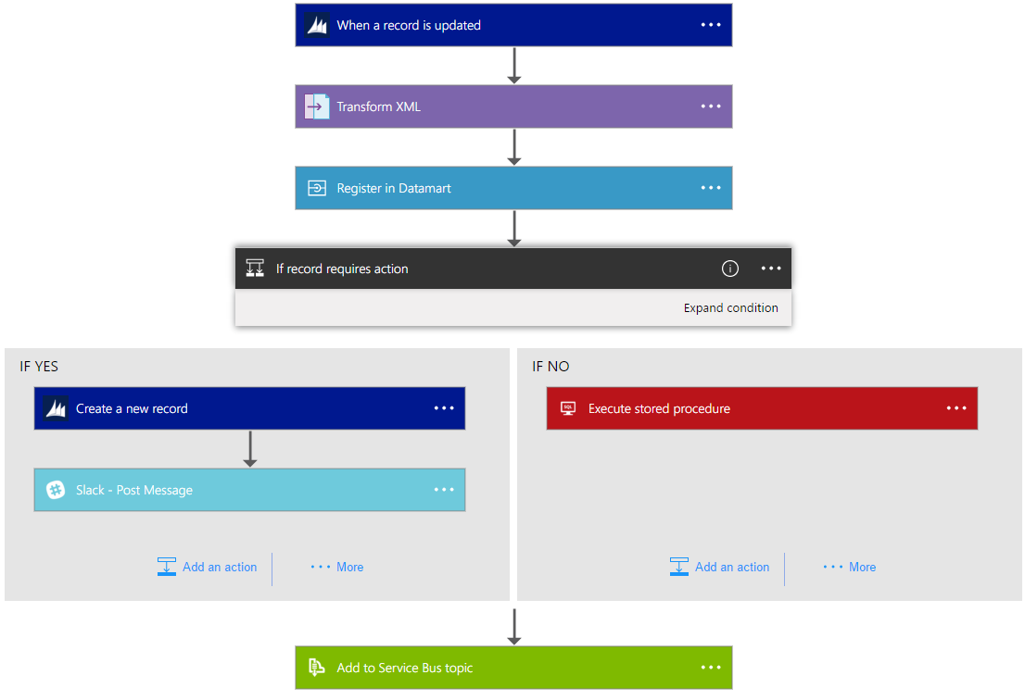
Logic Apps Workflow Designer
Workflow in the cloud
Powerful control flow
Connect disparate applications
No code designer for rapid creation
Also works within Visual Studio for added CI/CD

Slide 39
Logic Apps
SaaS
Protocols/native
appFigures
Asana
Azure API Management
Azure App Services
Azure Automation
Azure Cognitive Face API
Azure Cognitive LUIS
Azure Cognitive Text Analytics
Azure Cognitive Vision
Azure Data Lake Store
Azure Document DB
Azure Event Hub
Azure Functions
Azure Machine Learning
Azure Resource Manager
Azure Service Bus
Azure SQL
Azure Storage Blob
Azure Storage Queues
Basecamp
Bing Search
BitBucket
Bitly
Blogger
Box
Buffer
Campfire
Chatter
Common Data Service
Disqus
DocuSign
Dropbox
Dynamics AX Online
Dynamics CRM Online
Dynamics CRM Service Bus
Dynamics Financials
Dynamics Operations
Easy Redmine
Eventbrite
Facebook
FreshBooks
Freshdesk
GitHub
Gmail
Google Calendar
Google Contacts
Google Drive
Google Sheets
Google Tasks
GoTo Meeting
GoTo Training
GoTo Webinar
Harvest
HelloSign
Infusionsoft
JIRA
Insightly
Instagram
Instapaper
MailChimp
Mandrill
Medium
Microsoft Project Online
Microsoft Translator
MSN Weather
Muhimbi PDF
Office 365
Office 365 Users
Office 365 Video
OneDrive
OneDrive for Business
OneNote
Outlook.com
Outlook Tasks
PagerDuty
Pinterest
Pipedrive
Pivotal Tracker
Power BI
Project Online
Redmine
Salesforce
Salesforce Chatter
SendGrid
SharePoint Online
Slack
SmartSheet
SparkPost
Stripe
Survey Monkey
Todoist
Toodledo
Trello
Twilio
Twitter
Typeform
UserVoice
VS Team Services
Webmerge
Wordpress
Wunderlist
Yammer
YouTube
Zendesk
HTTP, HTTPS
HTTP Webhook
FTP, SFTP
SMTP
RSS
Compose, Query, Parse JSON
Wait
Terminate
Workflow
Cloud APIs and platform functionality
Over 170 built-in connectors
Hosted and managed within the platform
Scales to meet your needs
First class designer experience
Rapid development
XML and EDI
XML Validation
Transform XML (+Mapper)
Flat File Encode
Flat File Decode
X12
EDIFACT
AS2
Integration Account Artifact Lookup
API connections
Authenticate once and reuse
Differentiate connection configuration
Simple to deploy
Portal experience for managing API Connections
Hybrid
BizTalk Server
File System
IBM DB2
Informix
Oracle DB
SharePoint Server
SQL Server
SAP
Websphere MQ

Slide 40









Logic Apps connectors— Over 170 and growing
….and more!

Slide 41


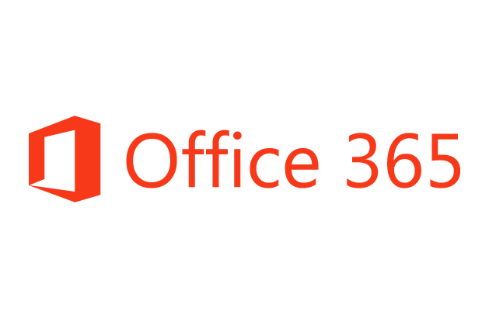

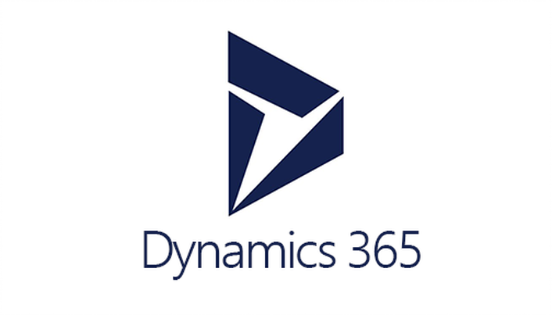






Logic Apps connects everything
Azure Functions
Service bus
Cognitive services
Logic Apps
Machine learning
On-premises data gateway
BizTalk server

Slide 42
Azure Event Grid

Slide 43






Manage all events in one place
Event publishers
Event handlers
Blob Storage
Azure Functions
Resource Groups
Logic Apps
Azure Subscriptions
Azure Automation
Event Hubs
WebHooks
Custom Events

Slide 44
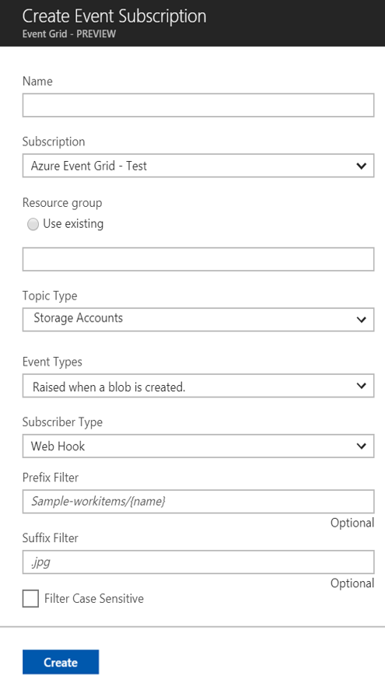
Manage all events in one place
Event publishers
Event handlers
Subscribe to pre-defined system events in Azure or create your own custom topics
Route events to any end-points, Azure or even beyond
Enable filtering and efficient routing of events

Slide 45
Ensure reliability and performance in your apps
Sub-second end-to-end latency in the 99th percentile
10,000,000 events per second per region
24-hour retry with exponential back off for events not delivered
Near real-time
Massive scale-out
High reliability

Slide 46
Benefit from broad coverage
Publishers
Subscribers
Immediately available
Immediately available
Blob Storage
Azure Functions
Resource Groups
Logic Apps
Azure Subscriptions
Azure Automation
Event Hubs
WebHooks
Custom Events
Coming soon
Azure Automation, Azure Active Directory, API Management, Logic Apps, IoT Hub, Service Bus, Azure Data Lake Store, Cosmos DB
Coming soon
Fabric Controller, Service Bus, Event Hubs, Azure Data Factory, Storage Queues

Slide 47
Demo

Slide 48
Suggestions for getting started
For existing services, start small. Replace 1 API or background processing item.
Integration is a great place to introduce serverless, because it is often a new layer on top of old layers.
Have fun with it – build something that makes your life easier that wouldn’t normally justify buying a whole server for.

Slide 49
Useful links
Azure function best practices:
https://docs.microsoft.com/en-us/azure/azure-functions/functions-best-practices
Azure function options overview:
http://markheath.net/post/azure-functions-choices
Azure function scaling insight:
https://www.azurefromthetrenches.com/azure-functions-significant-improvements-in-http-trigger-scaling/

